Slide 1
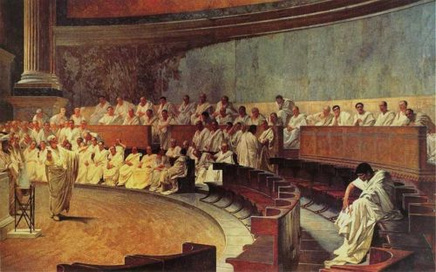

Crime and Punishment in Ancient Greece and Rome
The University of Western Ontario
Debra Nousek

Slide 2
‘The Five Things’
Author | Title |Date |Location | Language
CS 2301 Lecture Week 9: Criminals and Enemy Combatants

Slide 3
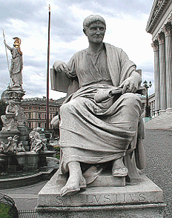
The Five Things:
Author: Gaius Sallustius Crispus (= Sallust)
Title: orig. title – unknown. Mod. title is Bellum Catilinae (Eng: Catiline’s War) Date: 44–40 BCE
Location: Rome Language: Latin
Statue of Sallust
CS 2301 Lecture Week 9: Criminals and Enemy Combatants

Slide 4
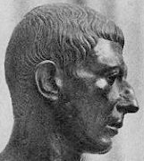
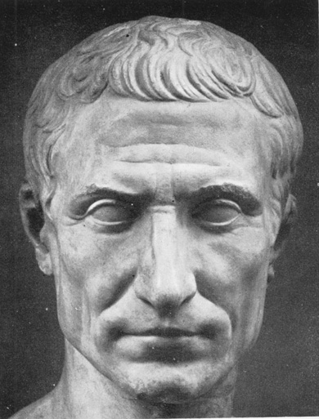
In the 60s BCE, there was political turmoil in Rome. The two main factions were the conservative optimates and the radical populares. Important participants include Marcus Tullius Cicero, Gaius Julius Caesar, Marcus Porcius Cato, and Lucius Sergius Catilina.
Portrait bust of Cato
Portrait bust of Julius Caesar
CS 2301 Lecture Week 9: Criminals and Enemy Combatants

Slide 5
Lucius Sergius Catilina was a noble patrician and a popularis. He was both an excellent general and a charismatic speaker. He was one of the most radical proponents of debt reform, advocating simply abolishing debts.
CS 2301 Lecture Week 8: Roman Law
CS 2301 Lecture Week 9: Criminals and Enemy Combatants

Slide 6
In 64 BCE Catiline ran unsuccessfully for the consulship of 63. He ran again in 63 for the consulship of 62. His platform called for the cancellation of debts and redistribution of land.
CS 2301 Lecture Week 9: Criminals and Enemy Combatants

Slide 7
Cicero as consul in 63 accused, probably unjustly, Catiline of trying to assassinate him. He showed up at the consular election wearing a breastplate and Catiline lost the election.
CS 2301 Lecture Week 9: Criminals and Enemy Combatants

Slide 8
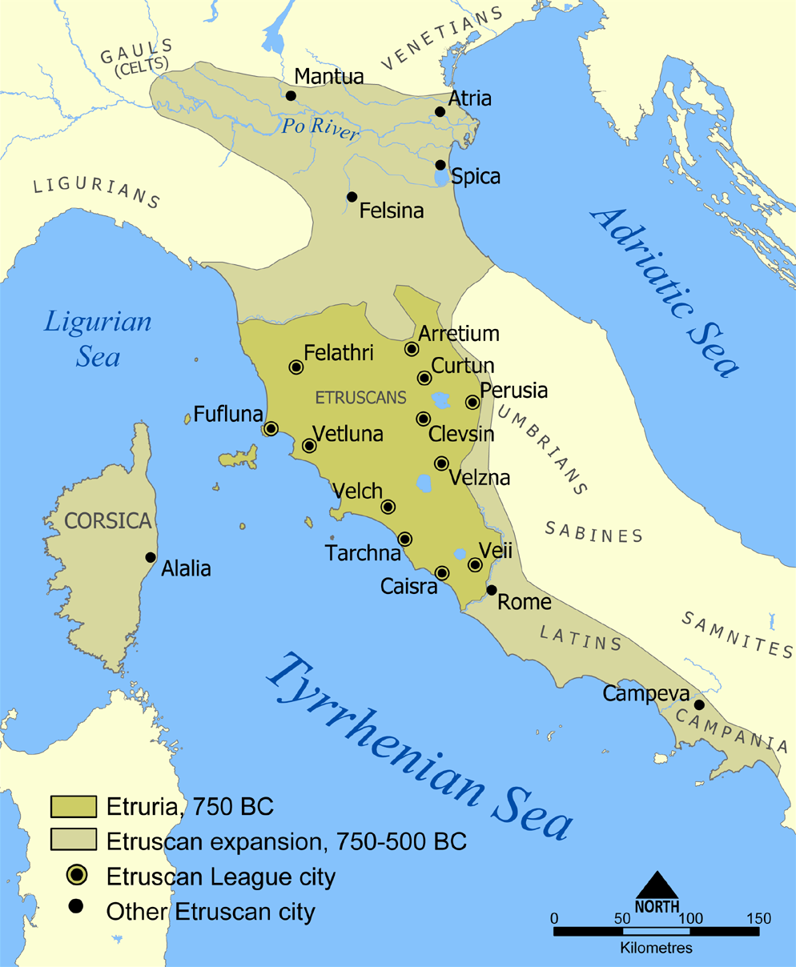
Catiline did not have a client army like Gaius Marius and Sulla had had, but he did have clients placed around Italy campaigning for him, most notably Gaius Manlius, who was in Etruria where there were a large number of recently evicted farmers and unhappy war veterans.
CS 2301 Lecture Week 9: Criminals and Enemy Combatants
Map showing the location of Etruria

Slide 9
After losing the election in July of 63, Catiline was getting serious about his plans to overthrow the government. On October 21st, the senate passed the so-called senatus consultum ultimum, advising the consuls to take extraordinary measures to ensure the safety of the state.
CS 2301 Lecture Week 9: Criminals and Enemy Combatants

Slide 10
On November 7th Catiline had organized his supporters to assassinate Cicero, set fire to Rome, and incite riots and slave revolts in Italy. Cicero was tipped off and managed to prevent the assassination and arson.
CS 2301 Lecture Week 9: Criminals and Enemy Combatants

Slide 11
On November 8th Cicero convened the senate and delivered a scathing speech. Catiline was present and called the accusations lies. The senate sided with Cicero and Catiline fled the city to join Manlius in Etruria.
CS 2301 Lecture Week 9: Criminals and Enemy Combatants

Slide 12
On December 3rd the captured envoys of the Allobroges, which was a tribe of Gauls, produced written evidence of the conspiracy and five of the conspirators, including Publius Cornelius Lentulus Sura and Gaius Cornelius Cethegus were arrested.
CS 2301 Lecture Week 9: Criminals and Enemy Combatants

Slide 13
On December 5th the senate voted to execute the conspirators. They sent the consul Gaius Antonius Hybrida to fight Catiline’s army in Etruria, and in January of 62 Catiline died in combat and his army was destroyed.
CS 2301 Lecture Week 9: Criminals and Enemy Combatants

Slide 14
Catiline’s War, page 5
L. Catilina, born of a noble line, had great strength of both mind and body, but a wicked and crooked disposition. From adolescence, internal wars, slaughter, seizures and civil disharmony were welcome to him, and there he spent his young manhood. His body was tolerant of hunger, cold and wakefulness beyond the point which anyone finds credible; his mind was daring, cunning and versatile, capable of any simulation and dissimulation; acquisitive of another's property, prodigal with his own; burning in desires; his eloquence was adequate, scant his wisdom. The enormity of his mind always desired the unrestrained, the incredible, the heights beyond reach.
CS 2301 Lecture Week 9: Criminals and Enemy Combatants
Notes:
14

Slide 15
Catiline’s War, pages 5-6
After the dominion of L. Sulla, he had been assailed by his greatest urge, to capture the commonwealth; and he attached no weight to the methods by which he might achieve it, provided he acquired kingship for himself. His defiant spirit was exercised increasingly each day by his lack of private assets and a consciousness of his crimes, both of which he had augmented by the qualities which I recalled above. He was incited, too, by the community's corrupt morals, which were afflicted by those worst and mutually different maladies, luxury and avarice.
CS 2301 Lecture Week 9: Criminals and Enemy Combatants
Notes:
15

Slide 16
Catiline’s War, pages 11-12
Finally he was captivated by love for Aurelia Orestilla (in whom no good man ever praised anything but her appearance), but, because she hesitated to marry him through fear of a stepson of adult years, it is believed for certain that he killed his son, thereby ensuring an empty house for the criminal marriage. It is this affair above all which seems to me to have been his reason for speeding up the deed: for his vile spirit—hostile to gods and men—could not be calmed by wakefulness or repose: to such an extent was his conscience preying upon his unquiet mind. Hence his bloodless complexion and ugly eyes, and his walk alternating between fast and slow; in short, there was derangement in his demeanour and face.
CS 2301 Lecture Week 9: Criminals and Enemy Combatants
Notes:
16

Slide 17
Catiline’s War, page 15
'You have already heard before, separately, what I have pondered in my mind. Yet my spirit is kindled more and more each day when I reflect what the conditions of life will be if we do not assert our freedom ourselves. For, ever since the commonwealth passed to the jurisdiction of a powerful few, it has always been to them that the dues of kings and tetrarchs go, that the taxes of peoples and nations are paid; the rest of us- all the committed and good, noble and ignoble - have been simply "the masses", denied favour, denied influence, beholden to those to whom, if the commonwealth thrived, we would be a source of fear. Hence all favour, power, honour and riches rest with them or are where they want them; to us they have left the dangers, rejections, lawsuits and destitution
CS 2301 Lecture Week 9: Criminals and Enemy Combatants
Notes:
17

Slide 18
Catiline’s War, page 20
He therefore referred the matter, already discussed beforehand in rumours amongst the public, to the senate. And so, as often happens in the case of some frightening business, the senate decreed that the consuls should do their utmost 'to prevent the commonwealth from suffering any damage’. That is the greatest power allowed to a magistracy by the senate according to Roman custom: to prepare an army, to wage war, to coerce allies and citizens by every means, and to wield the highest command and jurisdiction at home and on campaign. (Otherwise a consul has the right to none of these things without an order from the people.)
CS 2301 Lecture Week 9: Criminals and Enemy Combatants
Notes:
18

Slide 19
Catiline’s War, page 22
But when he had sat down, Catiline, prepared as he was to dissemble everything, with face downcast and suppliant voice began to demand of the fathers that they should not believe rashly anything concerning him: he was sprung from such a family, and he had regulated his life from adolescence in such a way, that he had good prospects in every respect; they should not reckon that, as a patrician whose own and whose ancestors' benefits to the Roman plebs were very numerous, he needed the destruction of the commonwealth--when it was being safeguarded by M. Tullius, an immigrant citizen of the City of Rome.
CS 2301 Lecture Week 9: Criminals and Enemy Combatants
Notes:
19

Slide 20
Catiline’s War, page 24
Nevertheless he himself delayed for a few days at the house of C. Flaminius in the territory of Arretium, while he furnished arms to a neighbourhood which was already galvanized; then, with the fasces and other insignia of command, he marched to Manlius in his camp. When this was found out at Rome, the senate pronounced Catiline and Manlius enemies and appointed a day before which the rest of their crowd (apart from those condemned on capital charges) could put down their arms with impunity. Apart from that, it decreed that the consuls should hold a levy, that Antonius with an army should speedily pursue Catiline, and that Cicero should act as defender of the City.
CS 2301 Lecture Week 9: Criminals and Enemy Combatants

Slide 21
Catiline’s War, pages 24-5
Such was the violence of the disease and the kind of rottenness which had attacked many of the citizens' spirits. And not only was there the mental derangement of those who were accessories to the conspiracy, but the entire plebs, in its enthusiasm for revolution, approved completely of Catiline's projects. That, indeed, it seemed to do from its own particular habit. For it is always those in a community who have no resources who resent the good and extol the wicked, who hate what is old and crave what is new, who in their hatred of their own circumstances are enthusiastic for everything to be changed, and who thrive on disruption and sedition with no concern, since destitution is a possession easily held without loss. But, in the case of the City plebs, there were many reasons for its headlong plight.
CS 2301 Lecture Week 9: Criminals and Enemy Combatants

Slide 22
Catiline’s War, pages 31-32
But, when Tarquinius named Crassus, a noble man of the greatest riches and the utmost power, everyone cried that the informant was false and demanded a motion concerning the matter—some deeming the matter incredible, others because, though they reckoned it true, it seemed that at such a moment so strong a man should be mollified rather than provoked, while very many of them were beholden to Crassus through personal business. And so a crowded senate, when consulted by Cicero, decreed that Tarquinius’ information seemed false and he should be kept in chains and given no further opportunity of informing except concerning the person whose scheme it had been that he should lie about so great a matter.
CS 2301 Lecture Week 9: Criminals and Enemy Combatants

Slide 23
Catiline’s War, page 36 (Caesar speaking)
The Lacedaemonians imposed on the defeated Athenians thirty men to handle their commonwealth. At first they began to execute, without trial, all the worst individuals and those resented by all: the people were delighted and said it was deserved. But after, when their licence had gradually increased, they killed good and bad indifferently at whim and terrified the rest with dread. So a community which had been oppressed by slavery paid a heavy penalty for its foolish delight.
CS 2301 Lecture Week 9: Criminals and Enemy Combatants
Notes:
23

Slide 24
Catiline’s War, page 37 (Caesar speaking)
Yet at that very same time, in imitation of Greek custom, they chastised citizens with lashes and exacted the ultimate reprisal from the condemned. But, after the commonwealth had matured and the number of citizens led to thriving factions and the innocent began to be entrapped and other things of this type to take place, then the Porcian Law and other laws were provided, laws by which exile was permitted to the condemned. This I think is, an especially good reason, conscript fathers, for our not adopting a new counsel. Naturally those who created so great an empire from small resources had better prowess and wisdom than there is in us, who scarcely retain what has been so well acquired.
CS 2301 Lecture Week 9: Criminals and Enemy Combatants
Notes:
24

Slide 25
Catiline’s War, page 37 (Caesar speaking)
'Should they therefore be discharged and Catiline's army be increased? Not at all. But I do propose as follows: that their money should be confiscated and they themselves held in chains in the municipalities which have the most effective resources; that no one afterwards should bring a motion before the senate concerning them nor discuss them in front of the people; and that the senate thinks that whoever acts otherwise shall be acting against the commonwealth and the welfare of all.'
CS 2301 Lecture Week 9: Criminals and Enemy Combatants
Notes:
25

Slide 26
Catiline’s War, page 37 (Cato speaking)
'Far different is my inclination, conscript fathers, when I contemplate the circumstances of our dangers and when I think over to myself the opinions of several of the members. They seem to me to have spoken about the punishment of men who prepared war against their own fatherland, parents, altars and hearths; but circumstances suggest that we should be wary of those men rather than that we should be deliberating what decision to take against them. Other misdeeds you pursue only when they have already been done but, unless you see to it that this one does not befall us, you will invoke the courts in vain when it has happened: when a city has been captured, the defeated have nothing left.
CS 2301 Lecture Week 9: Criminals and Enemy Combatants
Notes:
26

Slide 27
Catiline’s War, page 39 (Cato speaking)
For that reason, when you decide about P. Lentulus and the others, be assured that at the same time you are issuing a decree about Catiline's army and about all the conspirators. The more attentively you conduct these matters, the weaker the spirit in those quarters will be; but, if they see you wilt only a very little, all of them will soon make their defiant presence felt.
CS 2301 Lecture Week 9: Criminals and Enemy Combatants
Notes:
27

Slide 28
Catiline’s War, pages 39-40 (Cato speaking)
‘Citizens of the greatest nobility have conspired to burn their fatherland; they summon the Gauls, a people most hostile to the name of Rome, to war; the enemy leader and his army are poised over our heads: do you, then, still hesitate and doubt what to do with the enemies caught inside the walls? I propose that you take pity on them - mere young men who did wrong through ambition and discharge them still armed! Do not let your mercy and pity make you pitiable yourselves, should they take to arms! "Certainly the issue itself is harsh", you say, but you "do not fear it." …
[continued next slide…]
CS 2301 Lecture Week 9: Criminals and Enemy Combatants
Notes:
28

Slide 29
(continued from previous slide)
…Yet you do, and very greatly; but through idleness and soft-heartedness you hesitate, one waiting for another, evidently trusting in the immortal gods, who have often saved this commonwealth in its greatest dangers. Yet it is not by prayers and womanly supplications that the help of the gods is acquired; it is by watchfulness, action and good deliberation that everything ends successfully. When you submit to lethargy and apathy, you invoke the gods in vain: they are angry and hostile.
CS 2301 Lecture Week 9: Criminals and Enemy Combatants
Notes:
29

Slide 30
Catiline’s War, page 46
Meanwhile Catiline was active in the front line with his unencumbered troops: he helped the flagging, summoned the fit to take over from the injured, made every provision, fought hard himself, and often struck the enemy: he performed simultaneously the duties of committed soldier and good commander.
CS 2301 Lecture Week 9: Criminals and Enemy Combatants
Notes:
30

Slide 31
Catiline’s War, page 46
When Petreius, contrary to what he had expected, saw the great strength of Catiline's exertions, he led his praetorian cohort into the enemy's centre and, having caused great confusion there, killed them as well as others who resisted in various other places; then, from the flanks on both sides, he attacked the rest. Manlius and the Faesulan fell fighting amongst the foremost; as for Catiline, after he saw his forces routed and himself with only a few left, mindful of his lineage and his own old-time status, he rushed into the thickest of the enemy and there, fighting, was stabbed.
CS 2301 Lecture Week 9: Criminals and Enemy Combatants
Notes:
31

Slide 32
Catiline’s War, page 47
Yet neither had the army of the Roman people achieved a delightful or bloodless victory: all the most committed had either fallen in the battle or retired seriously wounded. As for the many who had emerged from the camp for the purposes of viewing or plundering and were turning over the enemy corpses, some discovered a friend, others a guest or relative; likewise there were those who recognized their own personal antagonists. Thus, throughout the entire army, delight, sorrow, grief and joy were variously experienced.
CS 2301 Lecture Week 9: Criminals and Enemy Combatants
Notes:
32

Slide 33
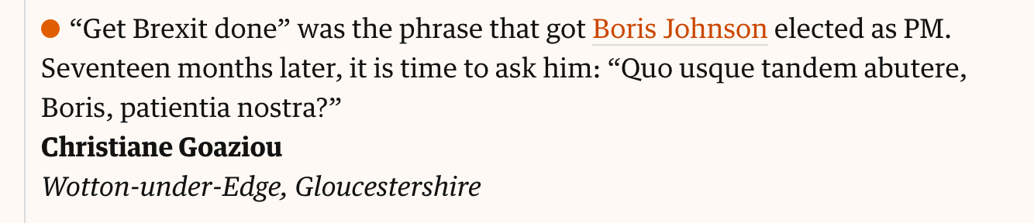


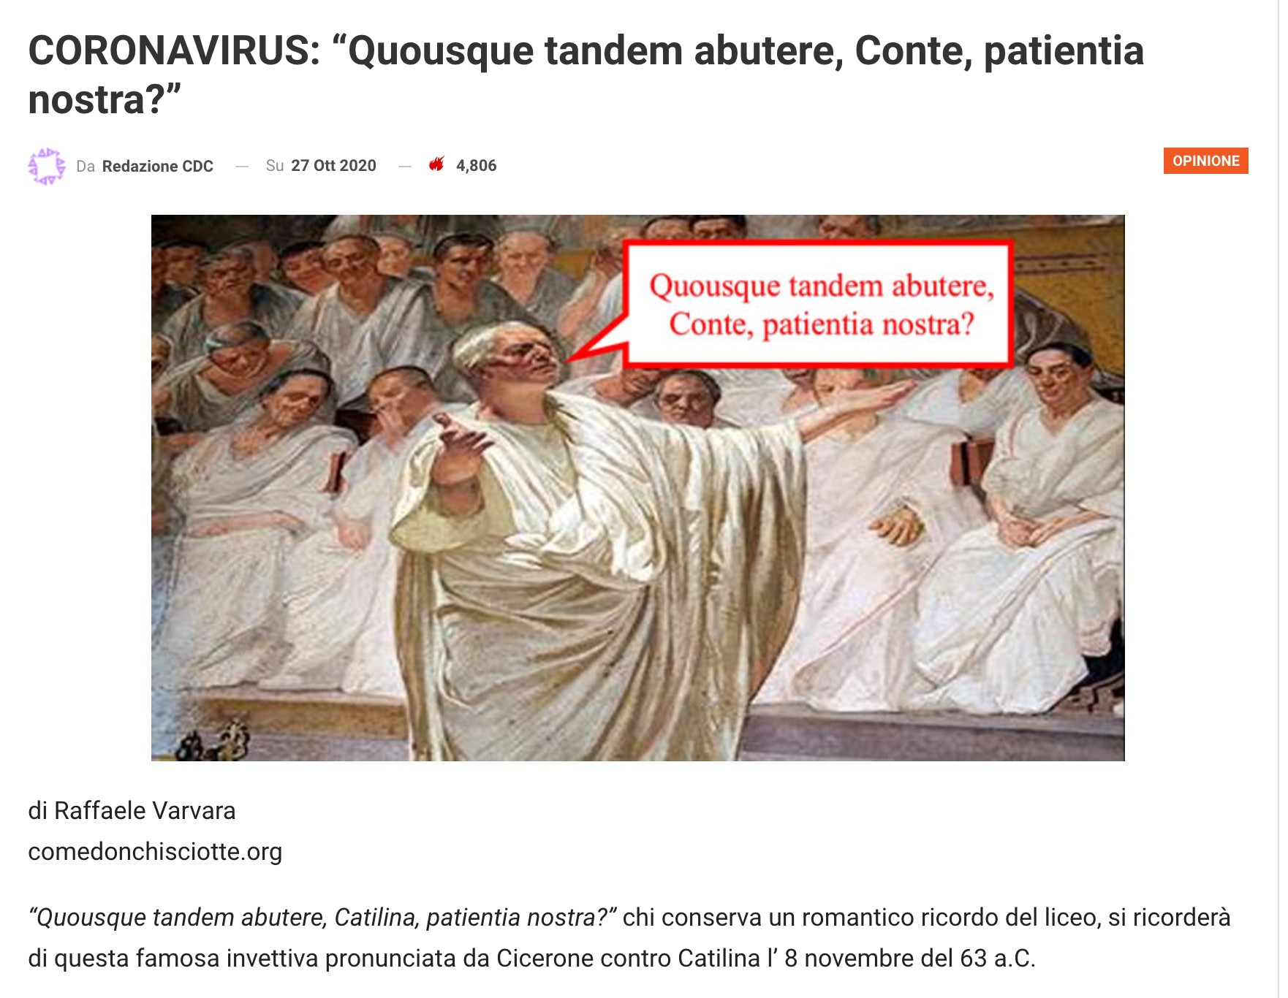

Slide 34
Crime and Punishment in Ancient Greece and Rome
The University of Western Ontario
Debra Nousek

